Slide 1
Speech Buddy
Kevin Dang
n01051682

Slide 2
Introduction/Proposal
An intelligent voice interface that is able to listen and interpret what the user has spoken. Input will be translated into text and stored in a SQL database
The problem this project solves is that it helps users take simple notes, such as a grocery list or small reminders for when you don’t have a pen and paper available. This project will help solved problems where people forget an important detail or appointment, by storing what the user says into a readable text format
Similar to Apples Siri and Microsoft’s Cortana

Slide 3
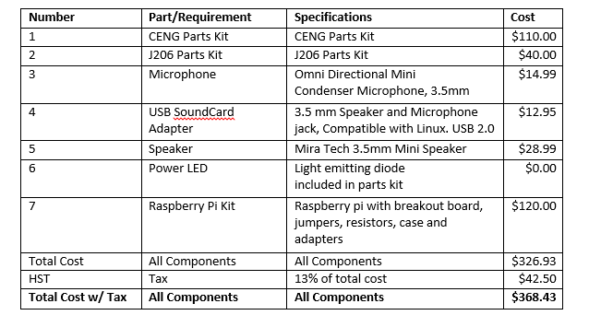
Budget

Slide 4
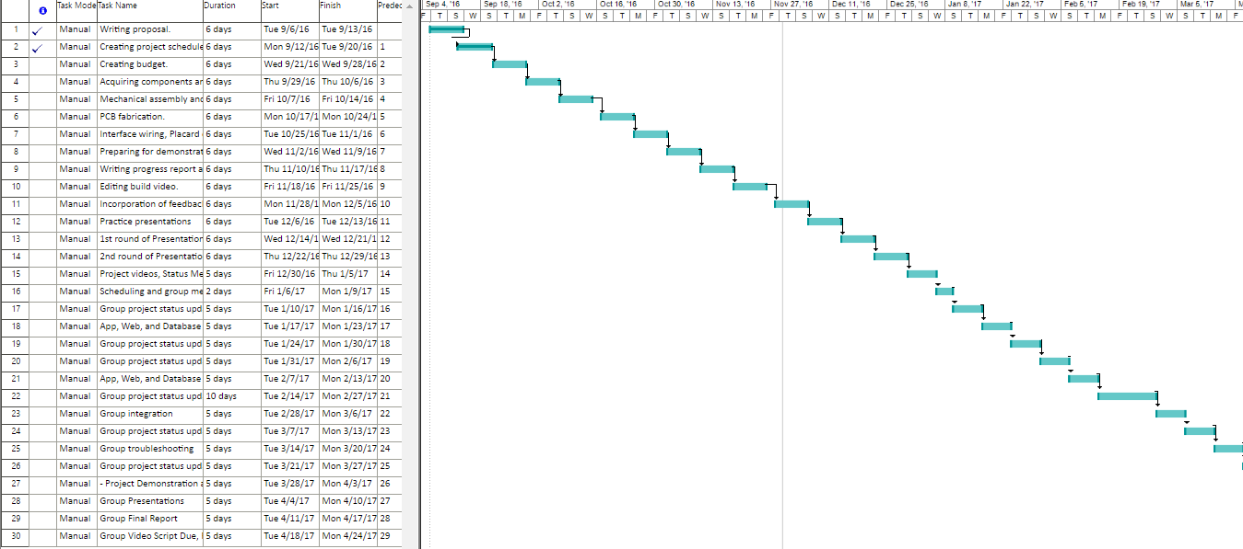
Schedule

Slide 5

Build Video

Slide 6
Previous Course Knowledge
Programming
TECH 104 Programming Fundamentals
TECH 212 Programming techniques in Java
CENG 200 Unix Scripting
CENG 254 Database with Java
Virtual Machine
TECH 151 PC Hardware and Operating Systems
CENG 256 Internet Programming
Planning
CENG 216 Intro to Software Engineering

